Slide 1

TECHNICAL SEMINAR
SEMI CUSTOM DESIGNS
VLSI
SUBMITTED TO:
Asst. Prof. ALOK KUMAR
(ECE Dept.)
SUBMITTED BY:
Vishal Kumar
(1702731168)
Ajay Kumar Garg Engineering College, Ghaziabad

Slide 2
CONTENT
Basics of Semi Custom Design
Performance analysis versus Design Time
Classification of semi custom design
Standard Cell
Sequence of operations
Advantage & Disadvantages
Gate array
Classification of gate array
Channeled gate array
Channel less gate array
Structured gate array
Advantages & disadvantages

Slide 3
BASIC OF SEMICUSTOM DESIGN
This method is used to reduce time to market.
In semi custom design, we use readily available library and block , So design of products will take less time and cost.
Here we reduce cost of designing of product
Performance of semicustom design is lower then full custom design.
Here in semi custom design we use readily available blocks, design library or modules.

Slide 4
Performance analysis versus Design Time
Full custom design
Longer design time until “maturity”
Semi custom design
Circuit performance
Short designing time until “maturity”
Less opportunities for performance improvement
More opportunities for performance improvement
Design time

Slide 5
Classification of Semicustom Design
Semicustom Design
Standard Cell
Gate Array

Slide 6
STANDARD CELL
DESIGN
Standard Cell
Standard Cell
Standard Cell
Standard Cell
Standard Cell
Standard Cell
Standard Cell
Standard Cell
Standard Cell
Standard Cell
Routing area
Standard Cell
Standard Cell
Standard Cell
Standard Cell
Standard Cell
5

Slide 7
STANDARD CELL
We use standard cell library.
A typical library may contain a few hundred cells including inverters, NAND Gates , NOR Gates , complex AOI/OAI Gates ,D-Latches, FF and Counters.
In library there are gates ,with different driving capabilities, for example, standard size, double size and quadruple size
We need to use size based on current driving capabilities and speed of device.
Designers sends the schematics to fabricators who prepares the mask if the cells are from the library.
Larger the library, the larger the cost.
Standard cell guarantees that it will work.

Slide 8
Sequence Of Operations
The Sequence of Operations in the Standard cell based designs are:
A Design is captured using the standard cell in the available in the library via schematic or HDL.
The layout is automatically placed and routed by CAD software
As the Complete layout is done, optimization of height is routing channel may be completed by good placement.

Slide 9
ADVANTAGES
Flexible design
Work with analog and digital function
Sophisticated system can be built easily
No special knowledge of internal transistor level designing cell is required.
Every transistor in every standard cell is can be chosen to maximize the speed and minimize area.
DISADVANTAGES
Masking Cost

Slide 10
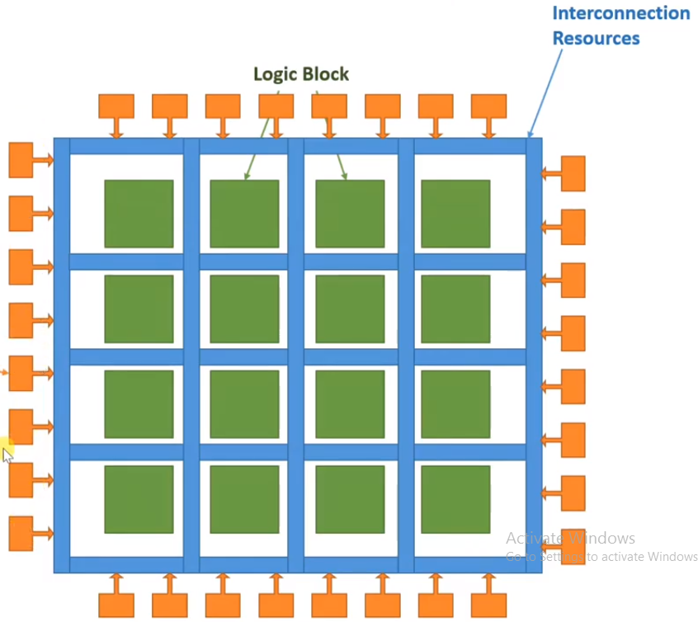
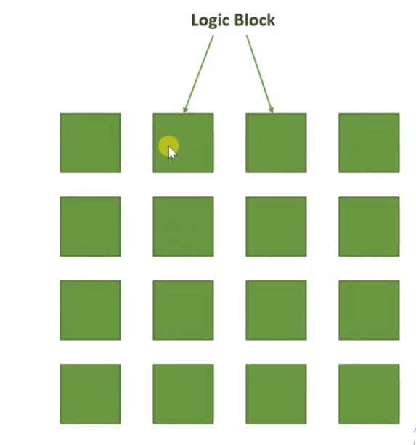
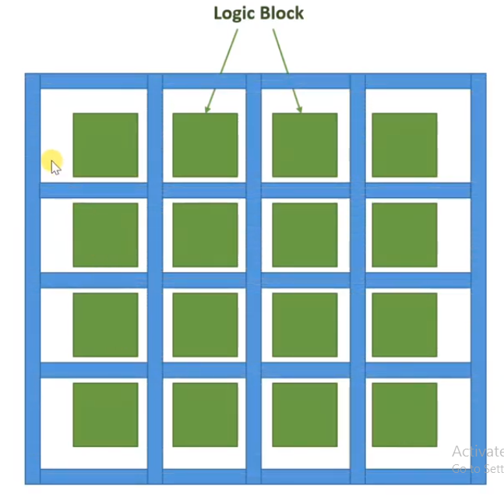
GATE ARRAY
IO cells
5

Slide 11
GATE ARRAY
Transistor level masking is fully defined
Program wiring and via to implement the desired function.
We take die which have all the gates placed but not connected.
Initially Gate Array is not connected with any logic block, after programming wiring is done with field
Only layout of interconnect is given to fabrication house. A gate array circuit is prefabricated circuit with no particular function in which transistor and other activity devices are placed at regulation predefined positions.
Only masks for metallization need to be created.

Slide 12
Classification Of Gate Array
Gate Array
Channeled gate array Channel less gate Array Structured Gate Array

Slide 13
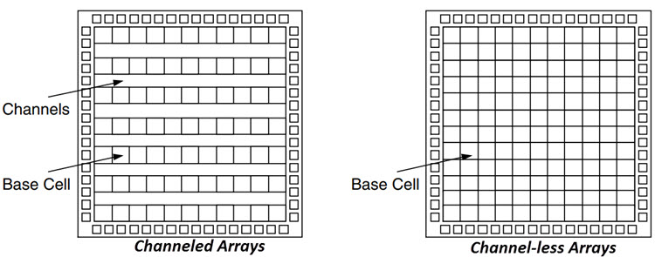
INTRODUCTION
CHANNELED GATE ARRAY
Only the customized interconnect is available.
It have predefined space between the row of base cells.
Manufacturing lead time is between two days and two weeks.
For interconnection, channelled gate array uses row of cells separated by channels.

Slide 14
INTRODUCTION
CHANNEL LESS GATE ARRAY
Only a few of the top layers are customized.
There are no predefined space between the rows of the base cell. No are set aside for routing between the cells.
Routing is made over the top of gate array devices.
Such routing is possible by contact layer customization
Channel less gate array have logic density. r.

Slide 15
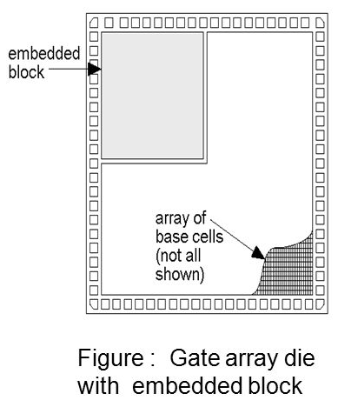
INTRODUCTION
STRUCTURED GATE ARRAY
It is the combination of both CBIC and Masked gate array
Only the interconnect is customized.
Custom blocks can be embedded.
These can be complete blocks such as processor or memory array
An array of different bases cells better suited to implementing a specific function.
Provided high speed & consume low power.

Slide 16
ADVANTAGES
Reduces the mask cost
Less time to market
Suitable for low production volume
DISADVANTAGES
Size is fixed
Number of transistor are fixed
Metal height is fix
2 metal layers are possible
Low efficiency

Slide 17


